Slide 1
Cloud Computing
Team 11: Sohal Patel, Erika Maglasang, Nathan Moran, Gabriel Rolink, and Tyler Samuelson

Slide 2
Presentation agenda
What is Cloud Computing?
Advantages of Cloud Computing
Disadvantages/ Issues with Cloud Computing
Compare and Contrast
Conclusion
Questions
Notes:
Agenda for the presentation, the security of the cloud is the main factor of this presentation

Slide 3
What is Cloud Computing?

Slide 4
“the practice of using a network of remote servers hosted on the internet to store, manage, and process data, rather than a local server or a personal computer.”
Definition

Slide 5
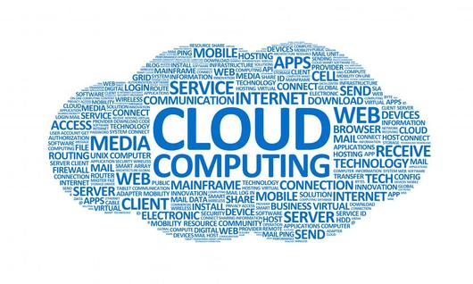
Why use cloud computing?
The cloud can be accessed from any location
The cloud is endless, it has no limit

Slide 6
Types of clouds
Private or personal Cloud
Personal information can be stored on this cloud so it needs to be kept secure
Open or Organizational Cloud
Information that is stored on this cloud will be shared with everyone that has permission to look at it
Hybrid Cloud
A mixture of private and open

Slide 7
The biggest obstacle cloud computing faces is the information security aspect of it. Information is spread on multiple devices, and this poses a threat to the private and open security.
The problem statement

Slide 8
The Advantages of Cloud Computing

Slide 9
Advantages
Provides high security.
Provides Virtual Space for an organization to store sensitive information.
Efficient for Return on Security Investment. Least costs for better security.

Slide 10
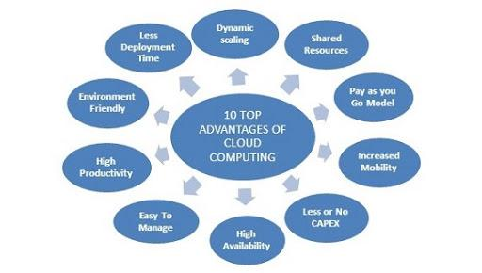
Pictorial Manifestation of ADVANTAGES

Slide 11
Advantages cont.
It provides symmetric and asymmetric encryption
It led for a better approach of Sensitive data of a personnel and an organization.

Slide 12
The Disadvantages/ Issues
of Cloud Computing

Slide 13
The Security of Cloud Computing
Security can be considered to be the biggest disadvantage of cloud computing.
Information stored in the cloud needs to be protected but it cannot be protected if the security is lackluster.

Slide 14
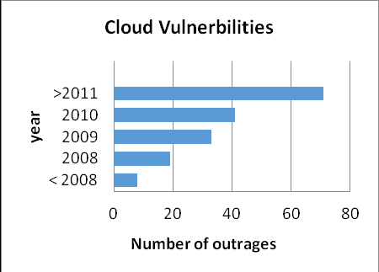
System Vulnerabilities of Cloud Computing
A vulnerability is a weakness of fault in a system.
Attackers can and will take advantage of these vulnerabilities and steal information from the system.
Information is stored in the cloud on several devices, and the more devices, mean the more vulnerabilities.
Addressing these vulnerabilities will improve the cloud in the long run.

Slide 15
Disadvantages
Inadequate Investigation/determination Increases Cyber-Security risks
Unexpected loss of sensitive information
Loss of confidentiality of Data:
Loss of Integrity of Data:
Loss of Availability of Data:

Slide 16
Disadvantage cont.
Social Engineering Attacks would also occur to phish the data from Cloud
Authorization and Authentication Concerns
Unintentional sharing or mistaken sharing of data
Client Information loss and financial data issues

Slide 17
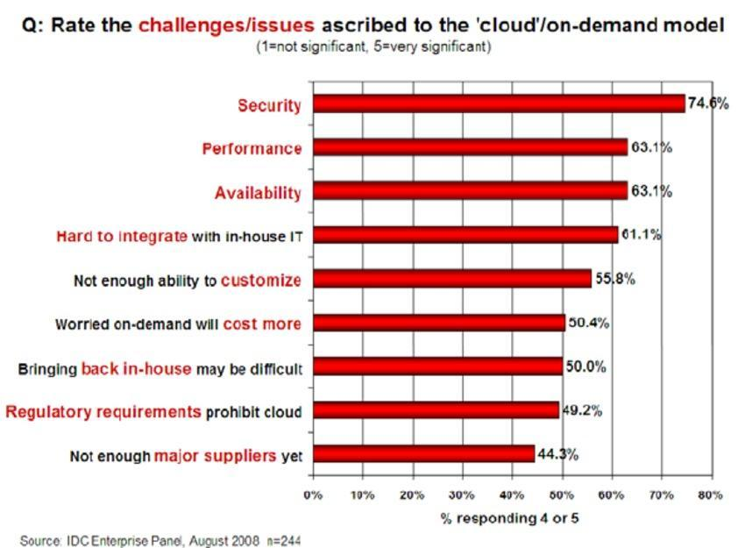
Security Issues - Figure

Slide 18
Comparing and Contrasting the Advantages and Disadvantages of Cloud computing
The cloud has many advantages but it also has disadvantages.
The disadvantages may outweigh the advantages in certain cases of use.
Vulnerabilities create the biggest disadvantages.
Issues must be addressed to improve cloud computing in the future as a whole.

Slide 19
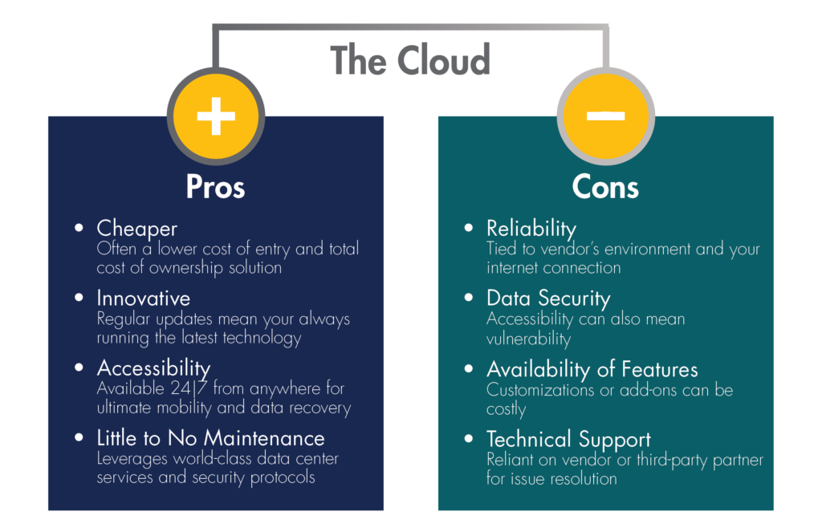

Slide 20
Conclusion
We have defined cloud computing.
We have determined advantages and disadvantages regarding the use of cloud computing.
We have compared and contrasted the pros and cons of cloud computing utilization.

Slide 21
Research Based Questions

Slide 22
What actually is cloud computing; how can it benefit an individual or an organization?

Slide 23
What are the security issues, vulnerabilities and disadvantages of Cloud Computing?

Slide 24
References
AI. "Cloud Computing Research." Proposed analysis (2017): 33.
AVRAM, MG. "CLOUD COMPUTING ADVANTAGES." CLOUD COMPUTING ADVANTAGES (2018): 22.
Husnain, Ali. "Cloud Computing - System Vulnerabilities." Cloud Computing (2020): 12.
INFO, IDC. "CLOUD SECURITY ISSUES." CLOUD SECURITY ISSUES (2008): 17.
Marinecsu, Dan C. "Cloud Computing Theory and Practise." Cloud Computing Theory and Practise (2013): 23.
Morrow, Timothy. "Risk, Threats, Vulnerabilities in Cloud." Risk, Threats, Vulnerabilities in Cloud (March 5, 2018): 12.
project, Enterprisers. "Private, open and hybrid cloud." Private, open and hybrid cloud (2015): 33.
Utley, Gary. "6 common cloud issues." cloud issues (2018): 12.
Woodford, Chris. "Cloud Computing." Cloud Computing (2018): 17.

